Slide 1
Drone Aid

Slide 2
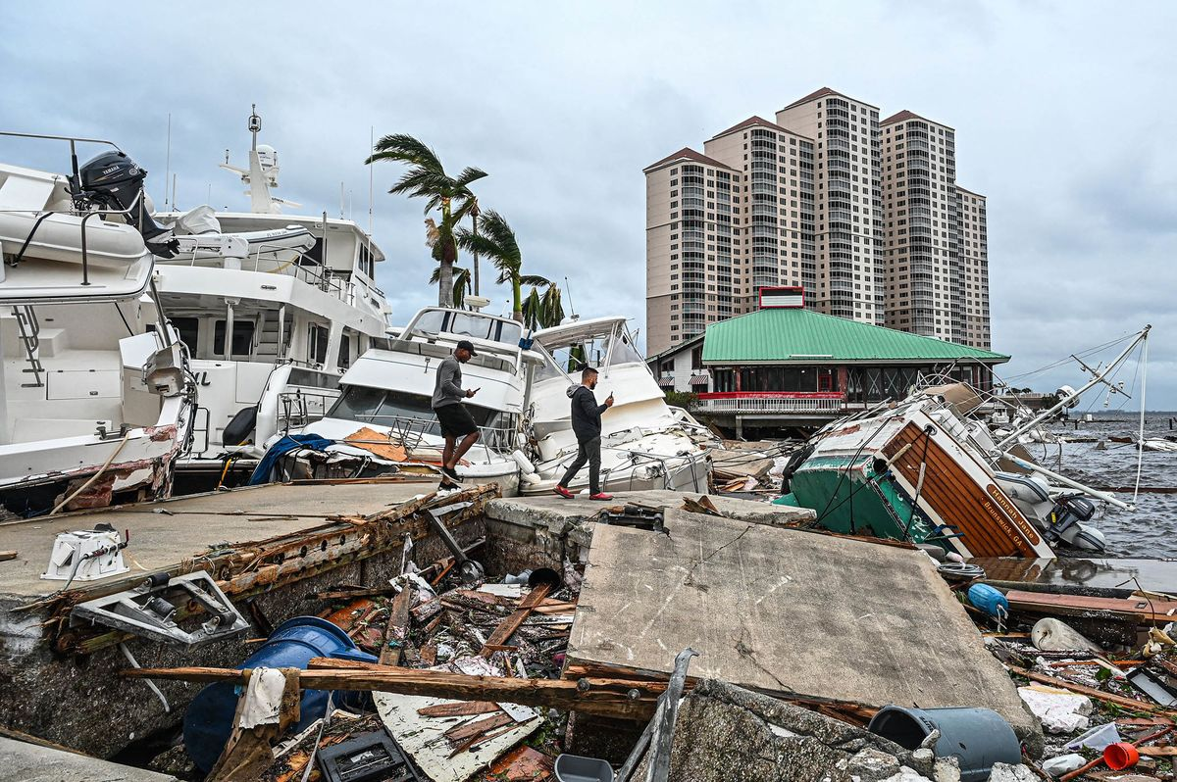
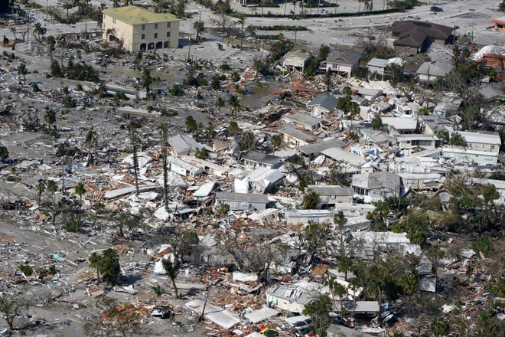
Effects
Debris littered the beaches
Boat washed ashore
Buildings fell apart and vanished
Small buildings were carried away by floods
Shops and restaurants were destroyed

Slide 3
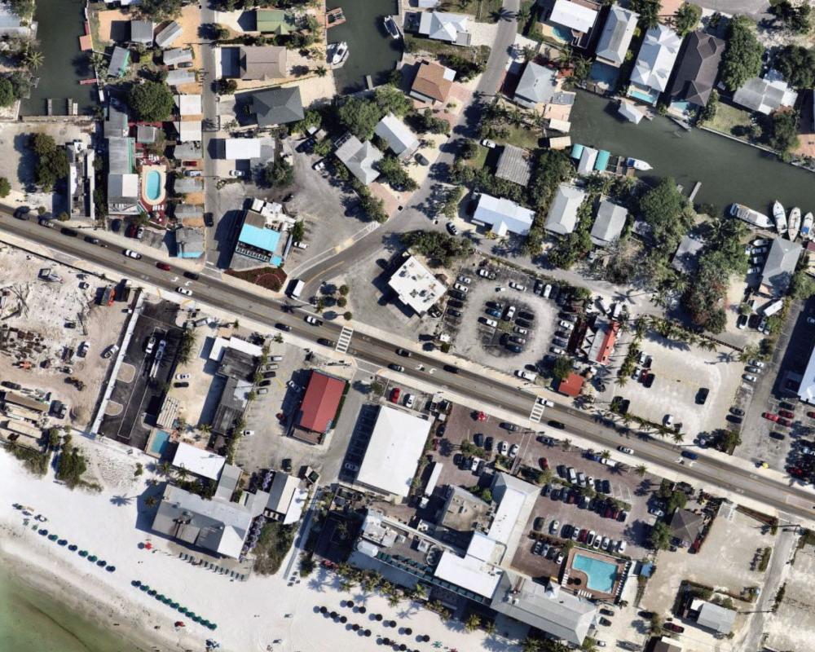
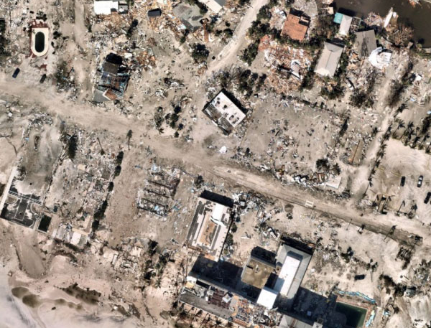
Before and After

Slide 4
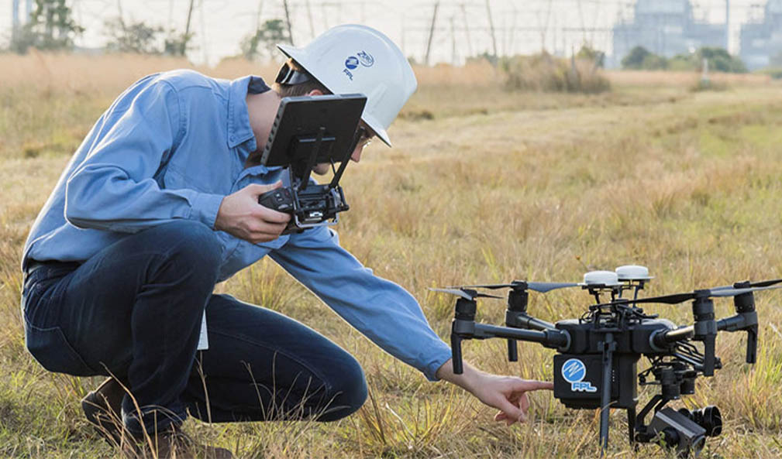
Outcome
Ian was being watched long before it hit Florida
More than 100 deaths have been reported
Became a hurricane as it turned North
There was at least 7.21 feet of storm surge in Fort Myers
Ian dumped
Almost 2500 people have been rescued as search and rescue continue to help others
More than 2.5 million power outrages

Slide 5
Demo
USER FLOW

Slide 6
Tools Used

Slide 7
Future Integrations

Slide 8




Slide 9
Thank You! To our Sponsors and Judges!

